Slide 1
Bumblebee lifecycle

Slide 2
Learning outcomes
I can describe the stages in a bumblebee’s lifecycle.
I can describe what bumblebees are doing at different times of year.

Slide 3
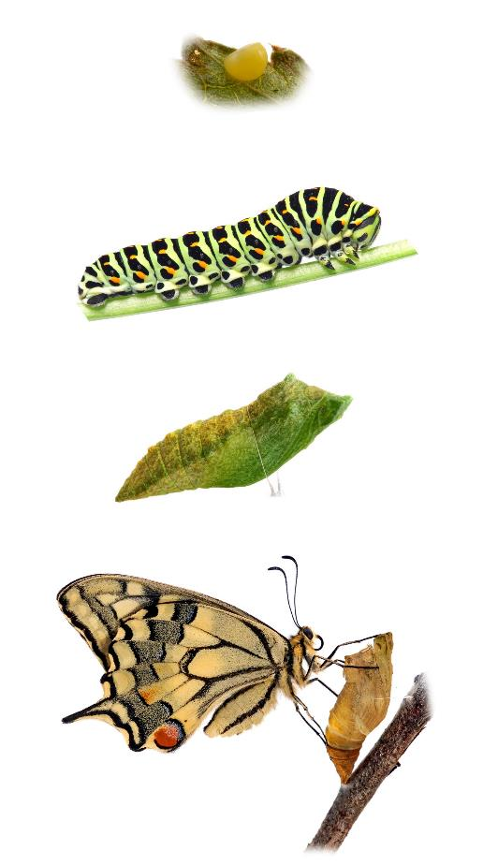
Key words
egg
Insect life stages
Larva (plural: larvae)
The baby stage of an animal, usually an insect. Larvae look completely different from the adult.
Pupa (plural: pupae)
The protective shell a larva lives inside as its body changes into the adult shape.
larva
pupa
adult
European swallowtail lifecycle

Slide 4
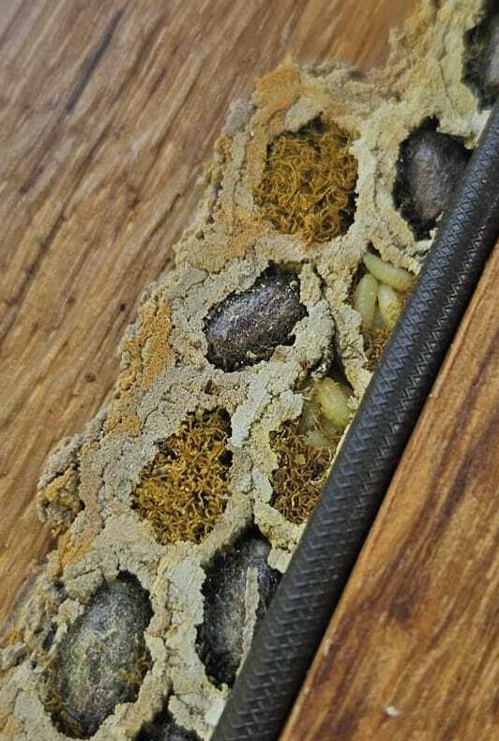
Key words
Mason bee nest in a window frame
Insect life stages
Cocoon
A case or bag made from a type of string called silk.
Some insects make cocoons to protect the pupa stage of their lifecycle. Examples include bumblebees, moths, and some beetles. This is not the same as a chrysalis. A chrysalis is a special word for the pupa of a butterfly.
cocoon
larvae
draught excluder
Image from iNaturalist user Milan Pippert. CC0 1.0

Slide 5
Key words
Insect lifecycle
Metamorphosis
The word for when there are big changes in an animal’s body as it grows up into an adult. Example: Caterpillar turning into a butterfly.
Pupate (PEW-pate)
The process of a larva changing into a pupa.
pupate
European swallowtail lifecycle

Slide 6
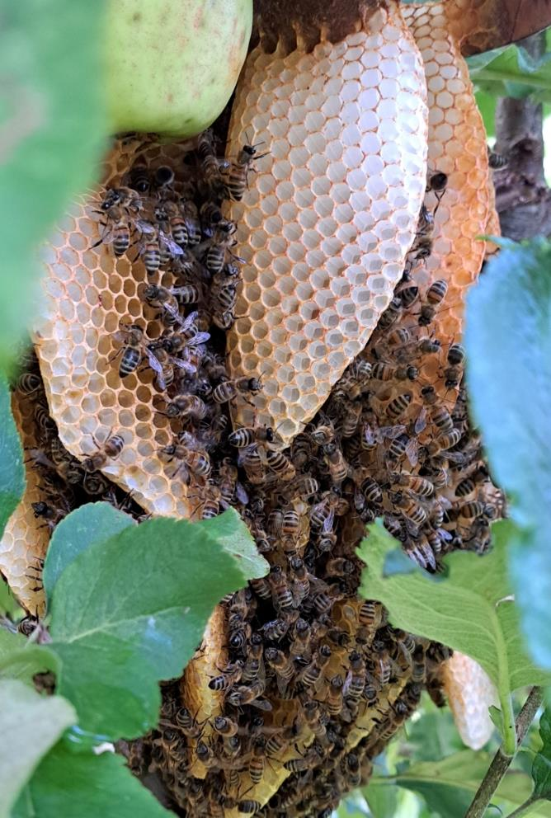
Key words
Bumblebee lifestyle
Colony
A group of one type of animal all living together.
Forage
To go looking for food.
A colony of honeybees
Image from iNaturalist user Andy Steele. CC BY-NC-SA 4.0

Slide 7
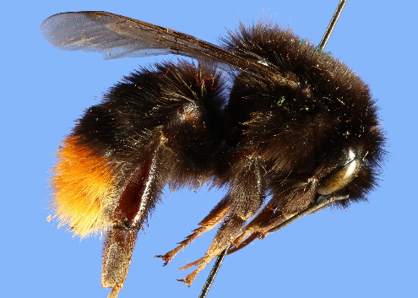
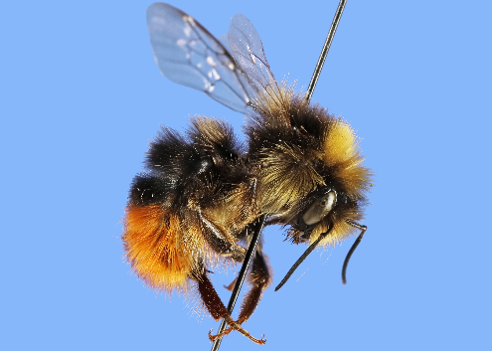
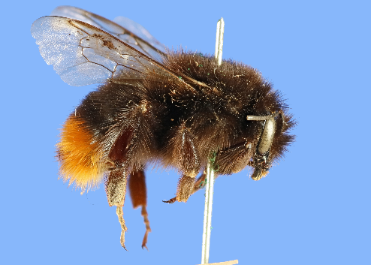
Key words
Types of bumblebees in a colony and what they do.
Queens
find a place to nest
collect pollen until the first workers grow up
lay eggs
Drones
- mate with queens
Workers
collect nectar and pollen
make honey
feed larvae
Red-tailed bumblebees
Notes:
Bumblebees usually live in colonies with only one queen.
A few species of bumblebees have more than one queen living in a colony.
Ants and bees can also have colonies with one queen or multiple queens.

Slide 8
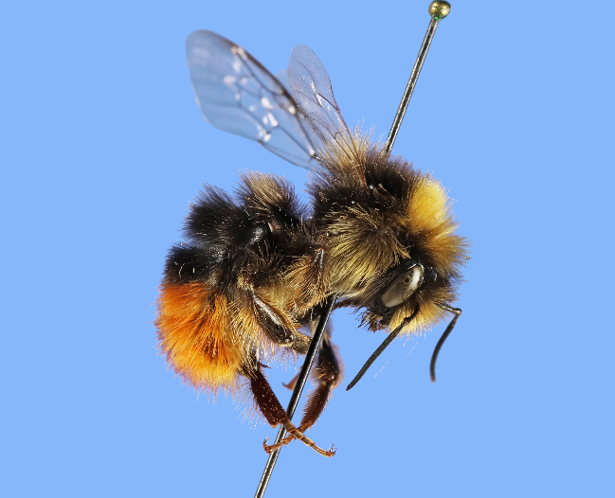
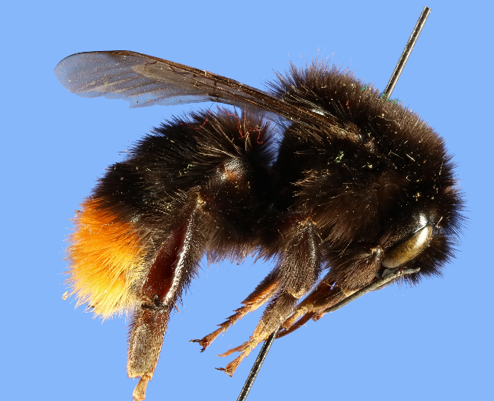
Key words
Red-tailed bumblebee drone
Types of bumblebees in a colony
Drone
A bumblebee that makes sperm.
Drones mate with queens. When a queen has mated, it can lay eggs that will hatch into workers. Bees and ants also have drones.
Red-tailed bumblebee queen
Notes:
Bumblebee drones are often much smaller than queens and sometimes have different colour patterns.
Drones have 13 segments on their antennae. Queens and workers have 12 segments.

Slide 9
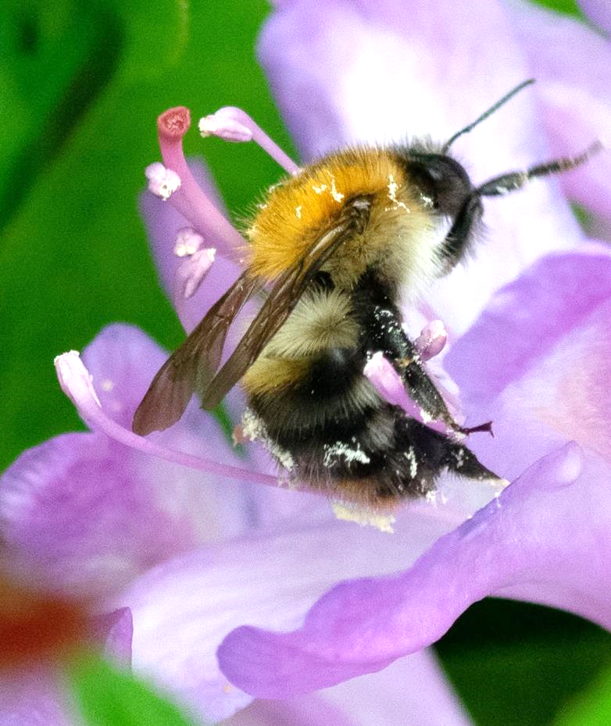
Key words
pollen
Plants and bumblebees
Nectar
Sweet liquid, usually made by flowers.
Pollen
Powder made by flowers.
Pollen is part of how plants make seeds in their lifecycles.
A bumblebee on a flower

Slide 10
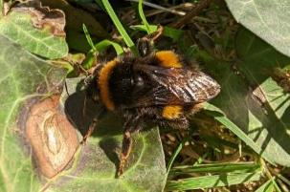
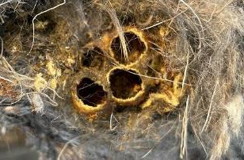
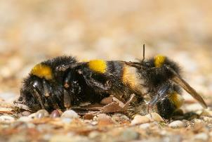
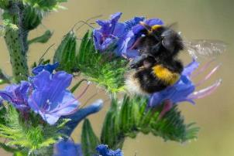
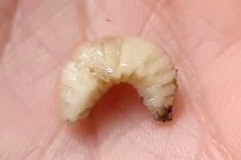
Bumblebee lifecycle
Image from iNaturalist. CC0
Image from iNaturalist. CC0

Slide 11
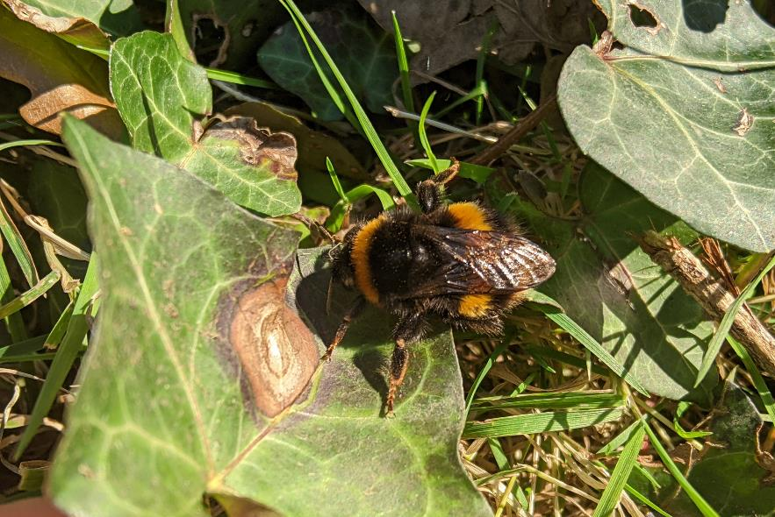
Queens wake up
In spring, queens wake up from hibernation and look for a place to make a nest and start their new colony.
Bumblebees can start being seen when temperatures come up to around 10̊C.
Bumblebee queen

Slide 12
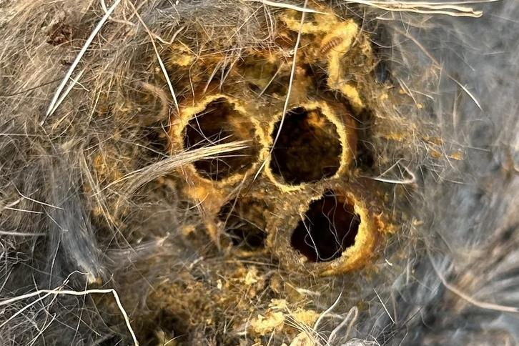
Building the colony
When the queen has found the right spot, they start to build cups from wax they make on their body.
The queen forages for nectar and pollen that she stores in these cups. Then she starts laying eggs on the pollen.
Bumblebee egg cups in old mouse burrow
Image from iNaturalist. CC0

Slide 13
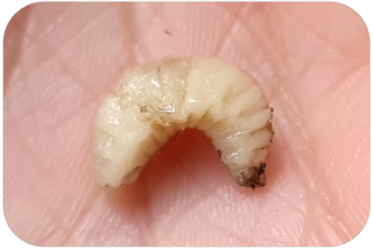
Larvae grow up
The eggs hatch, and the young larvae (baby bees) start to eat the pollen the queen has collected.
When the larvae have grown enough, they spin cocoons out of silk they make themselves. Inside the cocoon the larvae shed their skin and become pupae.
Bumblebee larva
Image from iNaturalist. CC0

Slide 14
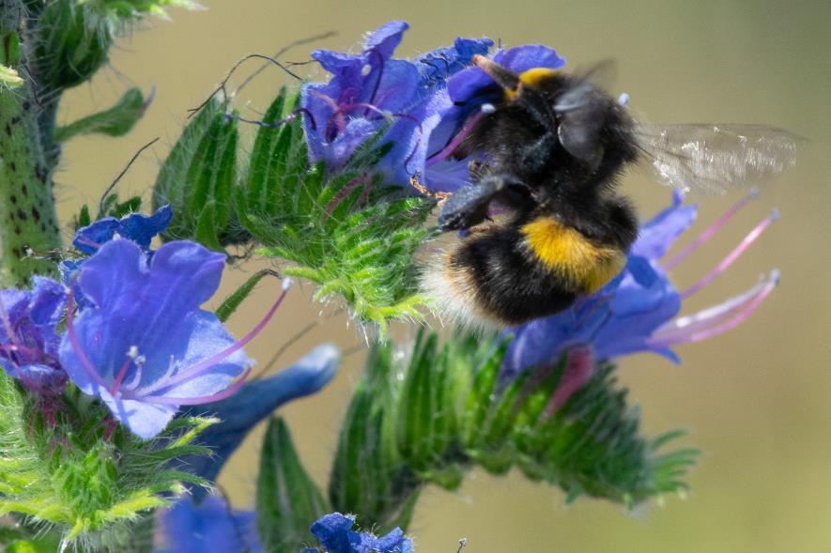
Worker bees get to work
Inside the cocoons, the pupae change into adult bumblebees. This process is called metamorphosis.
When metamorphosis is done, the adult worker bees chew their way out of their cocoons and get to work collecting nectar and pollen for the colony.
Now the queen can focus on laying eggs.
Adult bumblebee worker

Slide 15
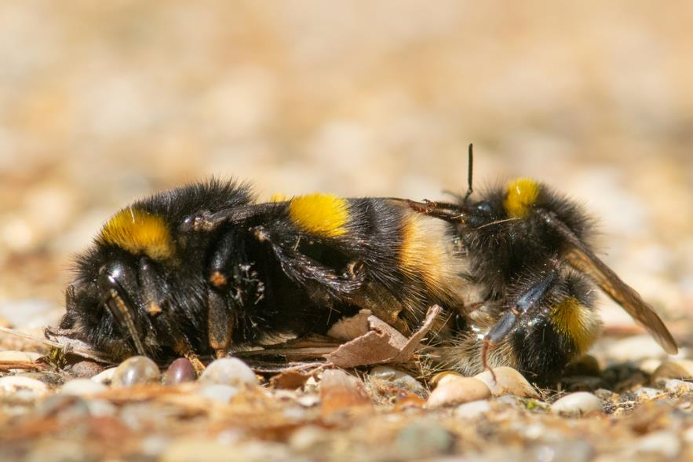
New queens prepare for winter
After a few months, some of the larvae metamorphose into drones and new queens.
These bumblebees leave the colony and fly off to mate.
Once they have mated, the young queens fly off to find a safe place to hibernate over winter.
Queen
Drone
Adult queen and drone bumblebee mating

Slide 16
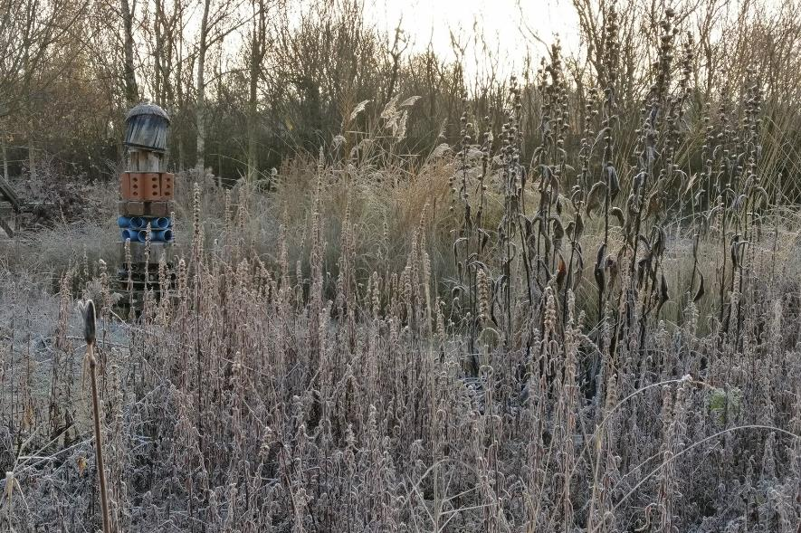
Winter rest
New queens hibernate in sheltered places like holes in logs or in tunnels they dig underground.
On sunny days, these queens will be very large bumblebees flying low to the ground or near piles of leaves.
The rest of the old colony dies out.
Winter landscape

Slide 17
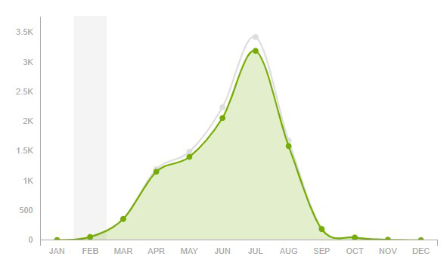
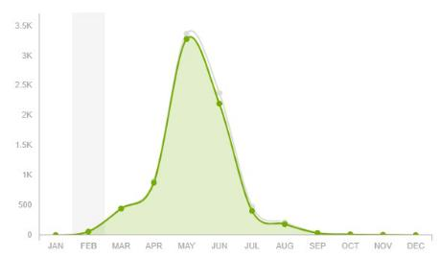
Not all bumblebees are the same
Sightings of early bumblebees
Different types of bumblebees wake up at different times of year.
Queens that wake up earlier in the year often have big colonies earlier too.
For example, Red-tailed bumblebee queens often wake up and start laying eggs earlier in the year than Early bumblebees.
Sightings of red-tailed bumblebees
Charts from iNaturalist

Slide 18
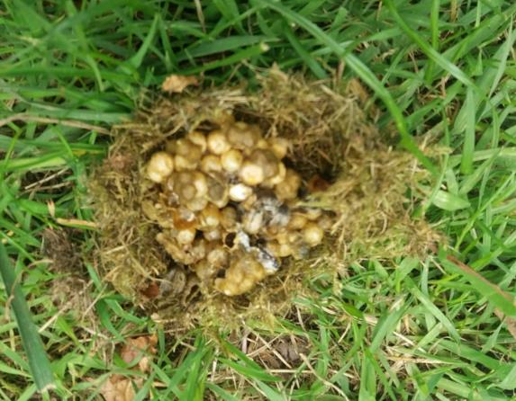
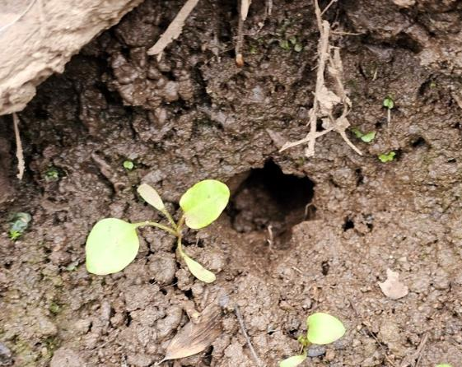
Bumblebees nest in different places
Different types of bumblebees tend to make their nests in different places.
Nesting places can include:
holes in trees
old mouse burrows
old bird nests
in thick grass
underground
Nest in grass
Image from iNaturalist user greenelsie. CC BY-NC 4.0
Nest underground
Image from iNaturalist. CC0

Slide 19
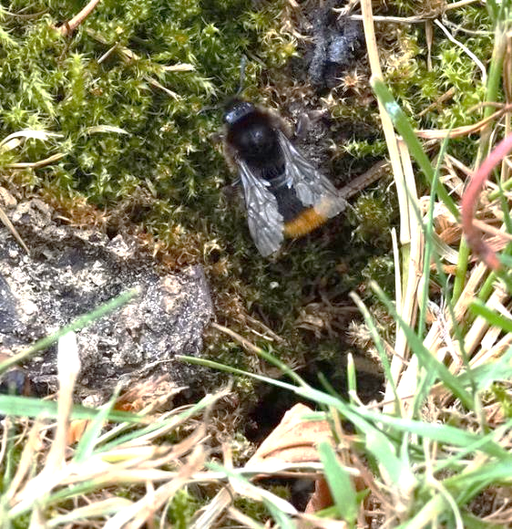
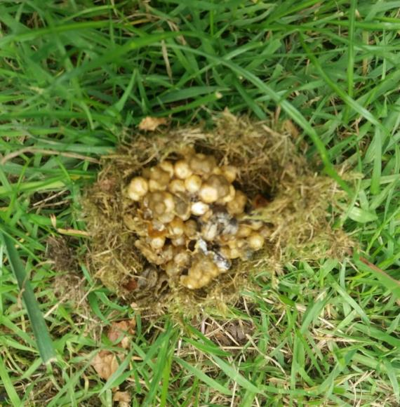
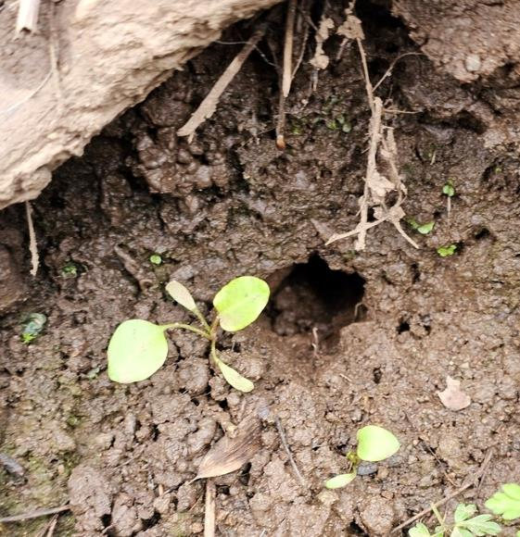
Bumblebees nest in different places
Nest in moss
Nest in grass
Nest underground
Image from iNaturalist user gwynmwilliams. CC BY-NC 4.0
Image from iNaturalist user greenelsie. CC BY-NC 4.0
Image from iNaturalist user Steve Milsom. CC0

Slide 20
Reflection questions
Based on what we now know about their lifecycle, is planting flowers the only way to help bumblebees?
Where might there be good nesting or hibernating sites for bumblebees in our school grounds?
*Why might time of year affect survey results?
*If doing the Nature Park pollinator count (link)
Notes:
Other ways to help bumblebees:
Flowers provide food for bumblebees, but what else do bumblebees need?
places to find shelter
materials for nests
How do bumblebees' needs change across a year?
places to nest in spring
places to hibernate in autumn and winter
Time of year could affect survey results
because different species wake up from hibernation at different times
different species might prefer certain flowers which bloom only at certain times of year

